Slide 1
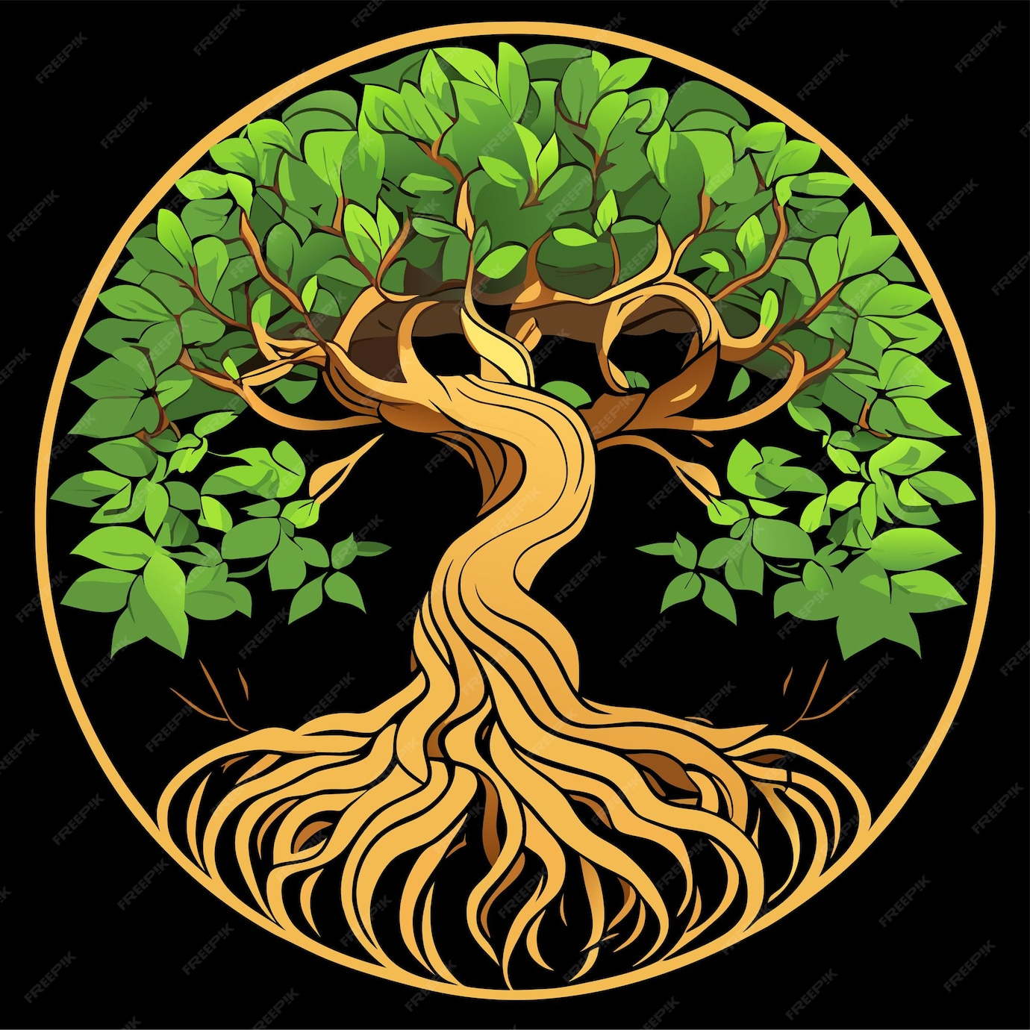
Recovering from Trauma and Neurosis: What Primal Therapy Can Contribute
International Psychohistorical Association — May 24, 2025
Trauma, Neurosis and irrational behaviors.
Neurophysiological process in coping with suffering.
Primal Therapy or “Neurosis in reverse”.

Slide 2
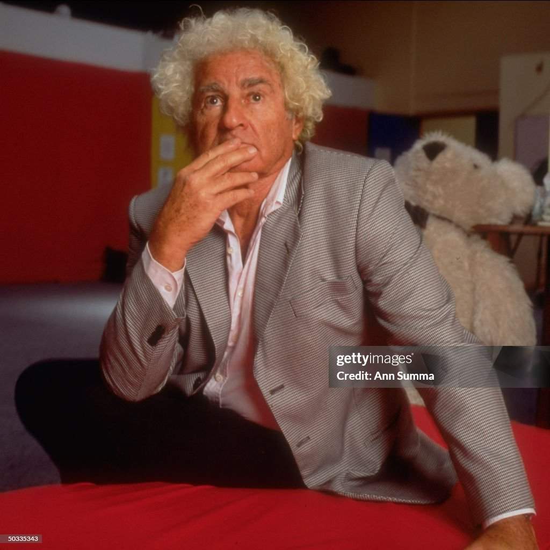
Articulation of the Presentation
The 60’s and the historical context.
What Primal Therapy is about and what it’s not.
Beliefs and ideologies as coping mechanisms.
The Primal Therapy process.
How could this process help in our daily lives and close environment?
Psychologist and psychotherapist Arthur Janov, creator of Primal Therapy, 1998.

Slide 3
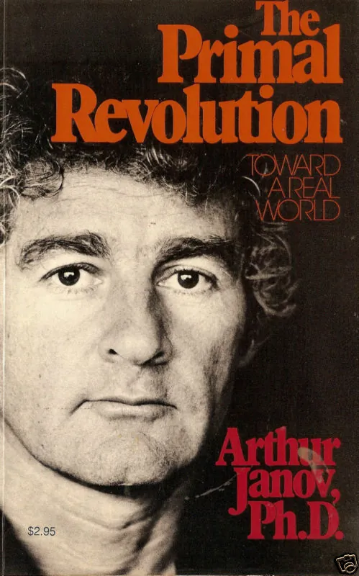
The Context of the 60’s
Non-fulfillment of fundamental needs in childhood.
Repression mechanisms at the root of neurosis.
Reversing the neurotic process by feeling repressed sufferings.
A formidable revolution in a favorable historical context.
Celebrities worked with Janov.
“Some years ago, I heard something that was to change the course of my professional life and the lives of my patients.”

Slide 4
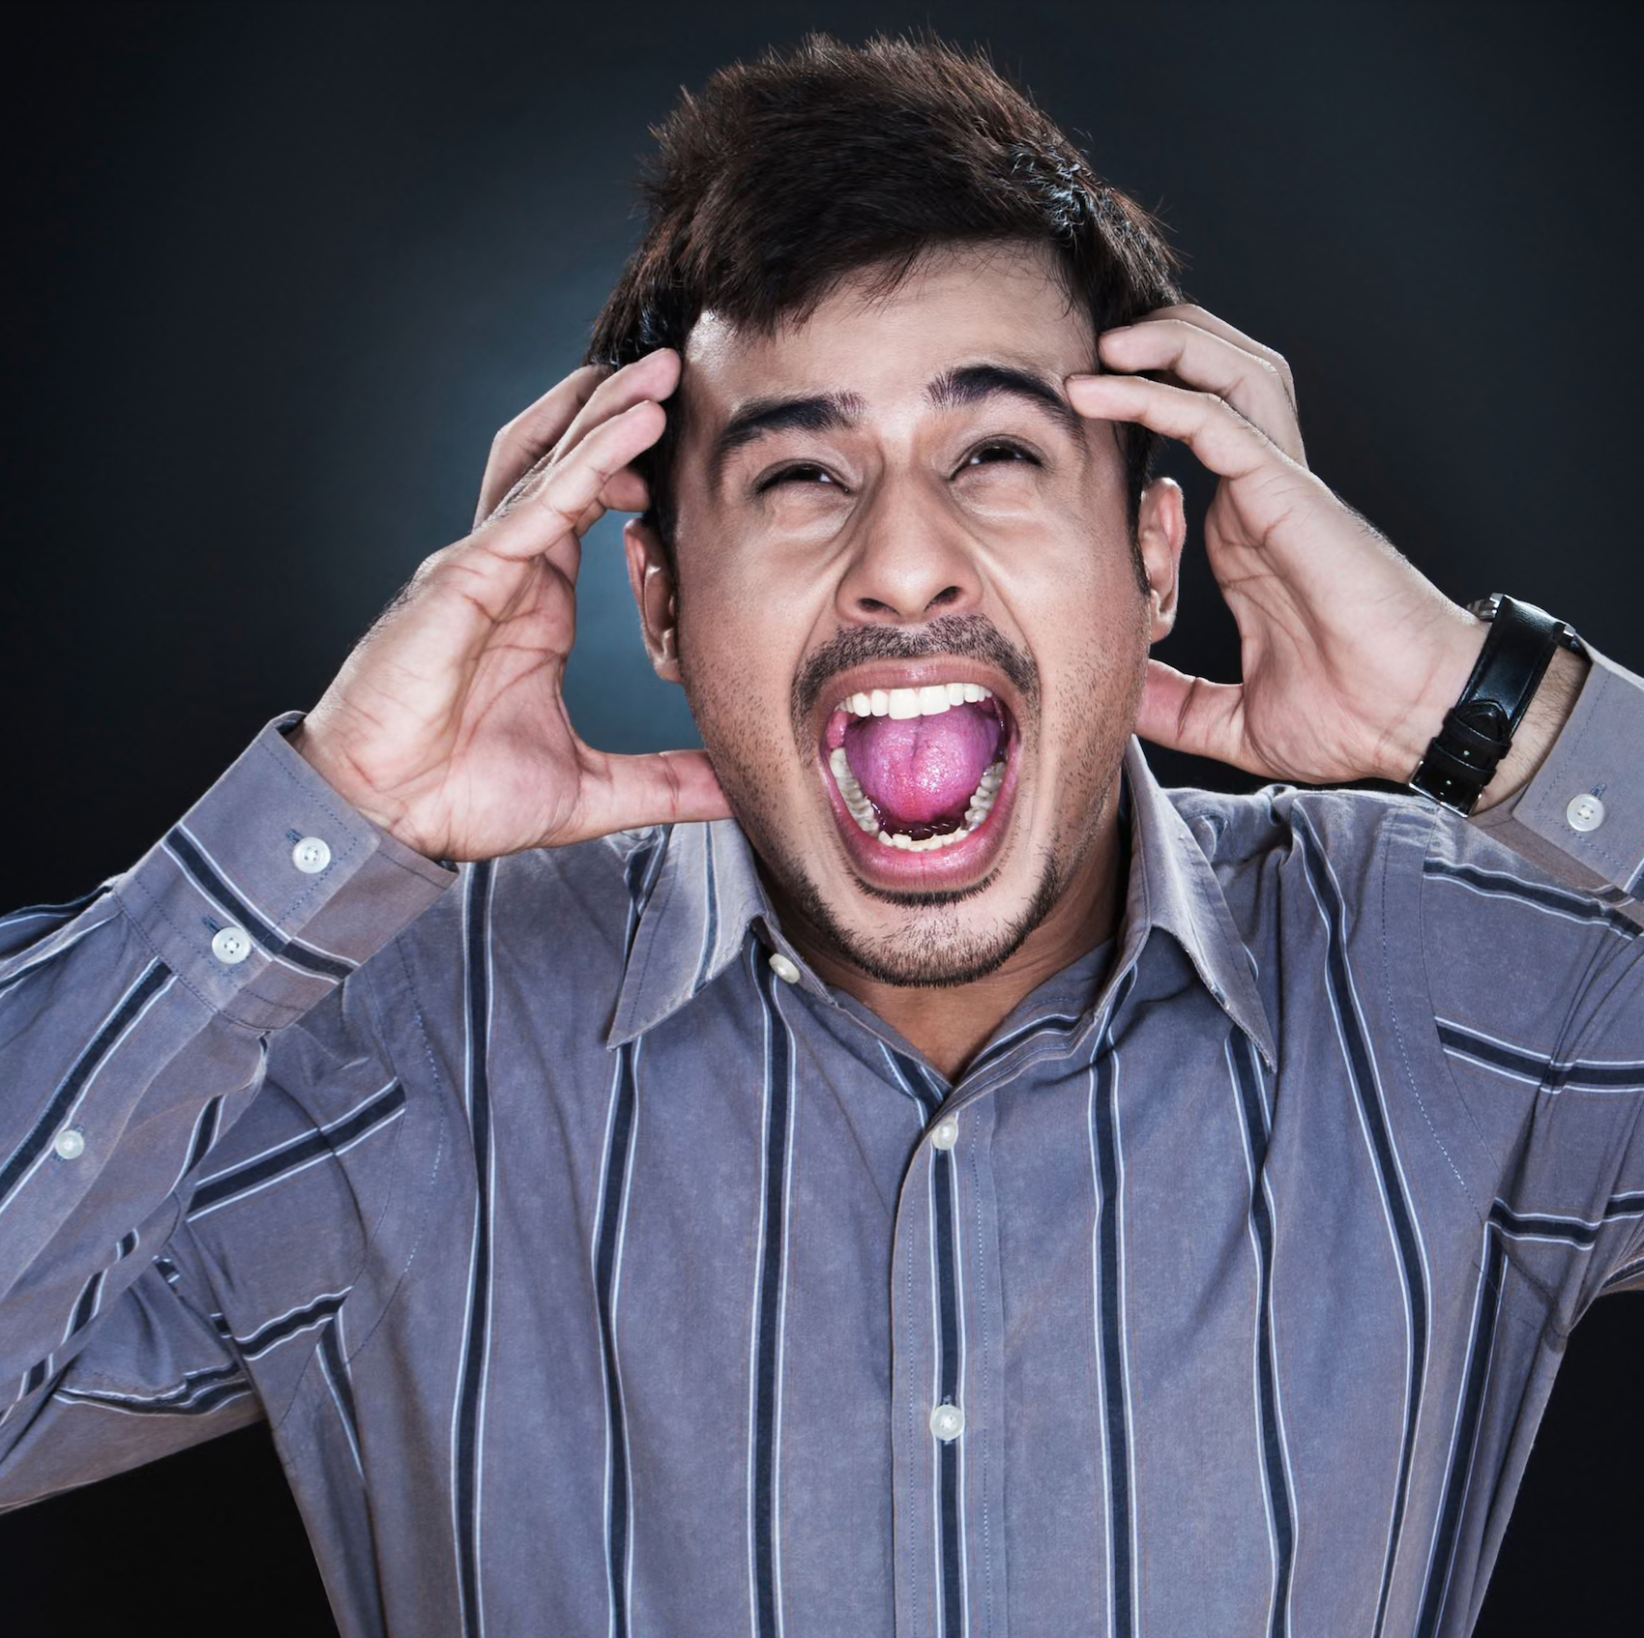
What Primal Therapy is About
Primal Therapy is not about screaming or retraumatizing.
Repression of suffering is our main survival mechanism.
Chronic tension generates a host of symptoms.
The personality splits into a Real and an Unreal Self.
“Neurosis is a symbolic behavior in defense against excessive psychobiolobic pain.
Neurosis is self-perpetuating because symbolic satisfactions cannot fulfill real needs.”

Slide 5
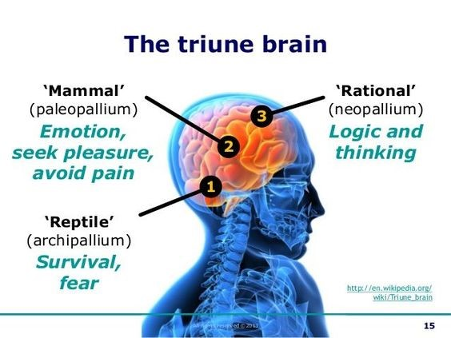
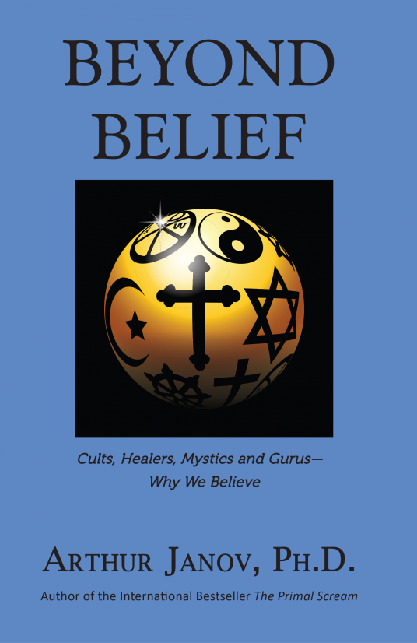
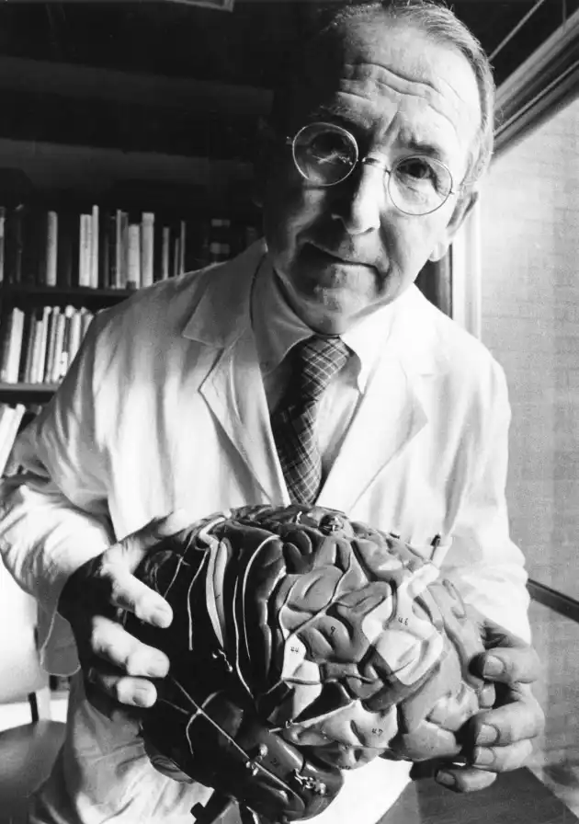
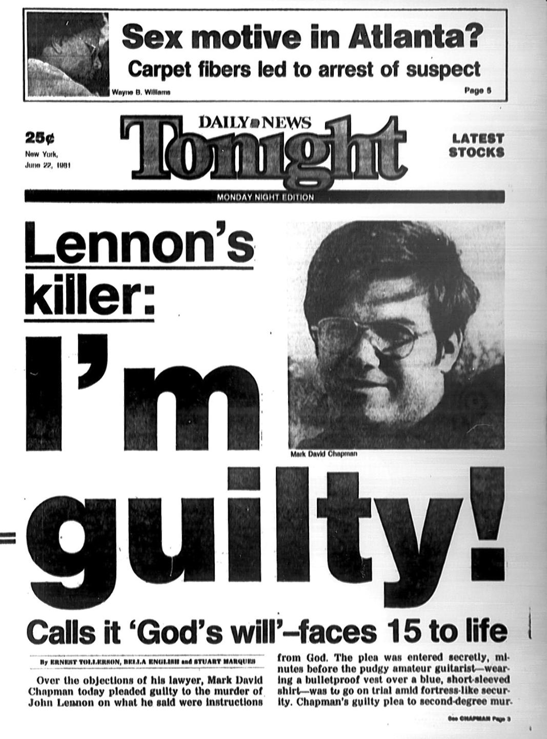
Belief as a Coping Mechanism
Trauma sets deviation of key structures in the brain.
A system of gating is being set up.
Feelings are suppressed but never disappear.
Feelings transpose into ideas and symbolic representations.
Challenge in belief means too much access to imprinted pain.
“Fervent believers most often have catastrophic very early lives.”
Primal Pain like geological fault lines.
Beliefs channel and absorb the energy of the pain, as does a pain killer.
Feelings of aloneness and hopelessness going back to the first months of life.
Patriotism as a defense against the fear of not belonging.
“Having unreal ideas as an adult is just a logical extension of what happened in early childhood.”
Dr Paul MacLean (1913-2007)

Slide 6
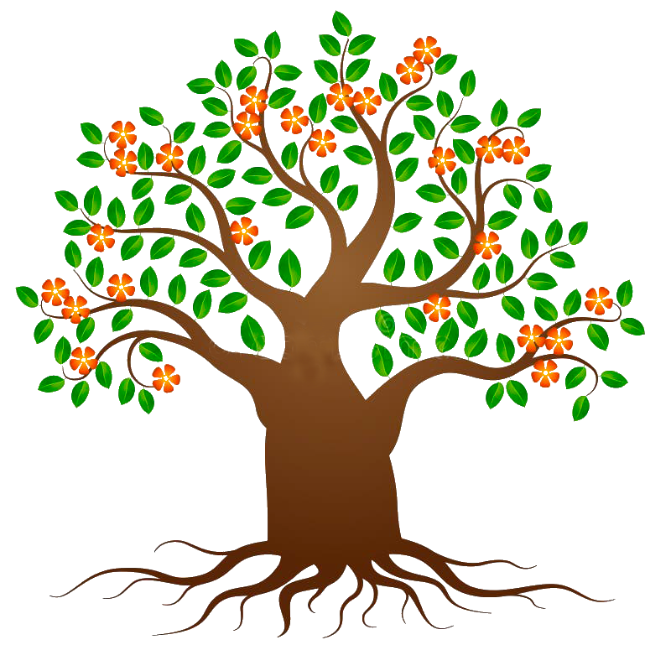
The Primal Therapy Process (1/2)
“Neurosis is a disease of feeling.” (The Primal Scream, 1970, p 20)
Taking neurosis in reverse.
From current experiences to earlier roots of suffering.
Centered on a person’s history and internal process.
Feelings at the heart of the therapeutic process.
Re-experiencing feelings puts an end to repression.
“We are inhuman to the extent that we cannot feel.” (Prisoners of Pain, 1980, p. 72)
“Feeling not only heals, it gives meaning.” (The New Primal Scream, 1991, p. 366)

Slide 7
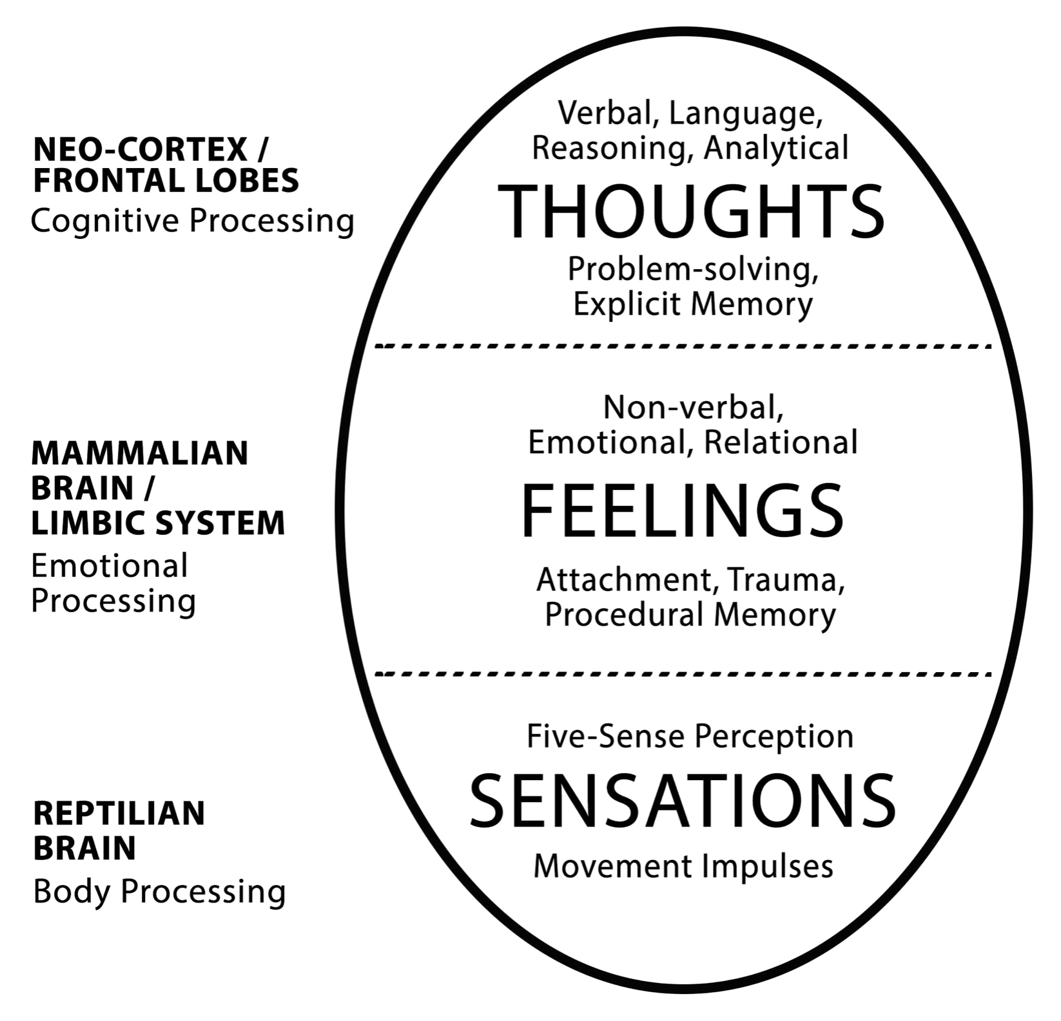
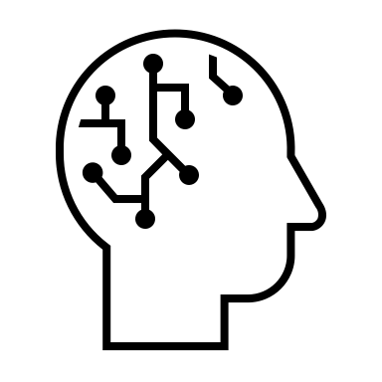
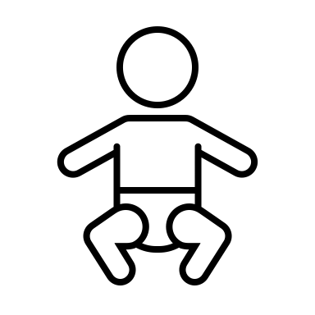
The Primal Therapy Process (2/2)

Slide 8
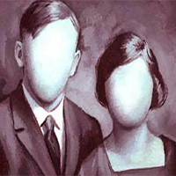
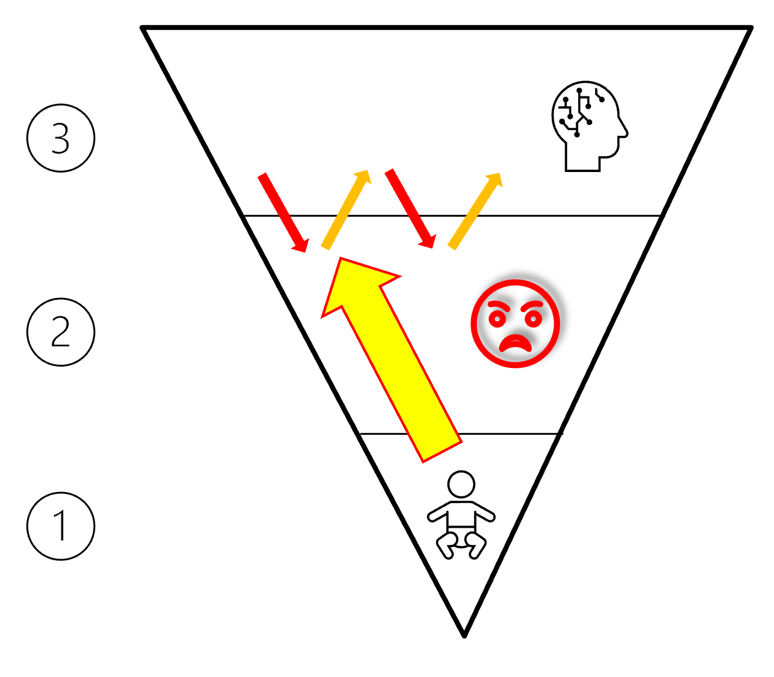
A Brief Illustrative Case Study
Oscillation between her feelings and her reasoning…
Connecting longstanding fear of men…
Mother routinely molesting her and shouting at her…
Bodily sensation of cold, disconnection akin to dying…
Mary a “blue baby” because of anoxia…
Unbearable re-experience of being dead and reanimated…
“I felt my body as a baby!”
Mary, a devoted housewife with two young children and a fervent Catholic…
Peter a highly controlling man…
Mary terrified by the prospect of following her own path…
“A part of myself has remained dead since then!”
“I’m not the source of the impulse to live!”
“So other people do what they want with me!”
Peter and Mary

Slide 9
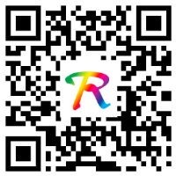
Self-Regulation in Public Debates
Dr Stuart Shanker’s MEHERIT Center on self-regulation.
Overstress and overreactions in the public debates.
Powerful subcortical brain processes at work.
Recognizing hidden stressors and triggers.
Finding space to restore calm and emotional balance.
Reflecting on our brain-body states.
“Feeling not only heals, it gives meaning.”
Collaboration Emma Perrot.
Beyond Belief—A Book Review

Slide 10
Questions Opened for Discussion
How do our hidden wounds resurface, particularly during troubled times?
In what ways do we cope with this resurfacing, both individually and collectively?
Could a better understanding of the three brain languages offer new paths for healing?
How can we move beyond the fight, flight or freeze response?
Can we learn how to self-regulate in public debates and discourses?

